Slide 1
UNIT – 3 Introduction to project management

Slide 2
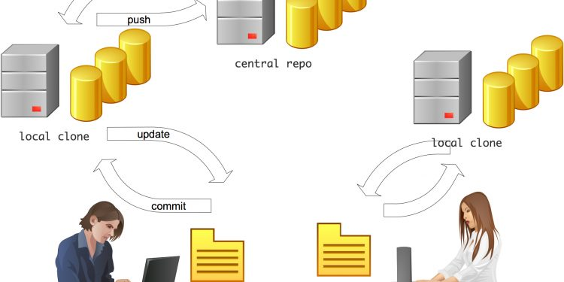

Slide 3
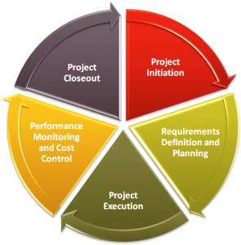
What is Project Management?
Project management is the use of specific knowledge, skills, tools and techniques to deliver something of value to people.

Slide 4
What Is Source Code Management?
Source code management is the concept of storing the source code for your software applications in a centralized, managed place. It’s used by software development teams, who are the ones that gain the most benefit from it due to the multiple developers they have.
The main people involved in source code management are the developers or programmers. They are the ones that are working on the code, making changes, adding features and requirements. The source code is a product of their work and it needs to be managed in some way.
Testers are also main users of source code. When they are required to test applications or features, they benefit from a source code management system and process, as it ensures they are working with accurate code and helps the team run better.

Slide 5
What Are The Benefits Of Source Code Management?
There are several reasons why we should manage the source code that we write:
Work together in teams. A source code management system allows multiple developers to access and change different areas of the code, without interfering with each other’s work. This is a big benefit for large teams of developers.
Version history. The system will keep a history of all saved changes to the code. This not only allows you to see what has changed in a file, but allows you to go back to a previous version if needed.
Generate release notes. Code can be linked to a release, and as a result, release notes can be generated. This means time is saved in generating it manually and searching for the changes.
Backup of code. A centralized place on a server where the source code is stored ensures there is a main location for the code (other than the developer’s machine). It also allows for easy backup of the code, depending on your server setup.

Slide 6
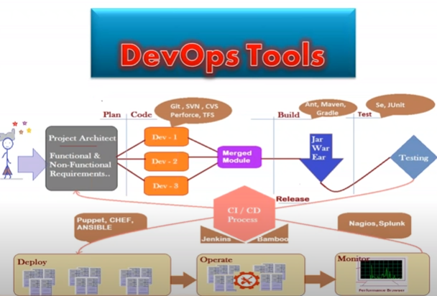

Slide 7
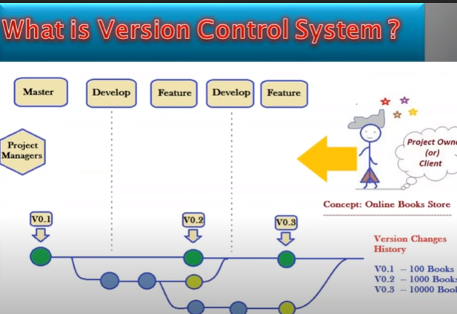

Slide 8
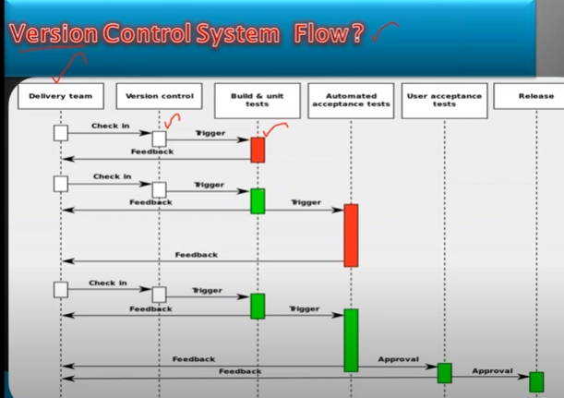

Slide 9
How Does Source Code Management Work?
The process works by a development team or company having a centralized server that stores all of the required code. This server is called the repository – the storage place for code. It can run various source code management systems, which are used to manage changes and different projects.
The system stores a copy of the source code as individual files, just like the developers have written it. When you want to make changes to some code, you perform what’s called a “check out” on the file. You get your own copy of the file in your environment. It also creates a “lock” on the file on the server, which means others can’t check out the same piece of code. This is to minimise the chances of someone overwriting your work.
Once you’ve made the changes, and tested them, you can save them onto the server using a process called “commit” or “check in”. This saves your code onto the server, replacing the existing file, and incrementing the version. It also removes the lock that was placed previously. You can usually add comments to this process, which allows you to specify what was changed.
This can all be done by different developers on different files. The source code management system will store this code and manage the changes that have been made.

Slide 10
Importance of Source Code Management¶
Track Changes – Changes can be tracked as someone making a change leaves a commit message about it.
Synchronization – The up-to-date codes can be fetched from the repository.
Backup and Restore – Files are saved at any time and restored from the last saved one.
Undoing – You can undo both the last known version and the last one created a long time ago.
Branching and Merging – Changes are made on a branch and after being approved, they can be merged with the master branch.
Identifying Conflicts and Preventing Overwrites – Overwrites are prevented and in case of conflicts, they are identified. SCM notifies the developers so that they can review these conflicts and resolve them.

Slide 11
What is a “version control system”? (OR SCM)
Version control systems are a category of software tools that helps in recording changes made to files by keeping a track of modifications done to the code.
Why Version Control system is so Important?
As we know that a software product is developed in collaboration by a group of developers they might be located at different locations and each one of them contributes in some specific kind of functionality/features.
So in order to contribute to the product, they made modifications in the source code(either by adding or removing). A version control system is a kind of software that helps the developer team to efficiently communicate and manage(track) all the changes that have been made to the source code along with the information like who made and what change has been made. A separate branch is created for every contributor who made the changes and the changes aren’t merged into the original source code unless all are analyzed as soon as the changes are green signaled they merged to the main source code. It not only keeps source code organized but also improves productivity by making the development process smooth.

Slide 12
Use of Version Control System:
A repository: It can be thought of as a database of changes. It contains all the edits and historical versions (snapshots) of the project.
Copy of Work (sometimes called as checkout): It is the personal copy of all the files in a project. You can edit to this copy, without affecting the work of others and you can finally commit your changes to a repository when you are done making your changes.
Types of Version Control Systems:
Local Version Control Systems
Centralized Version Control Systems
Distributed Version Control Systems

Slide 13
Local Version Control Systems: It is one of the simplest forms and has a database that kept all the changes to files under revision control. RCS is one of the most common VCS tools.
It keeps patch sets (differences between files) in a special format on disk. By adding up all the patches it can then re-create what any file looked like at any point in time.

Slide 14
The Basic Terminology of Version Control System:
Working Directory:
Where developers are required to create/modify files.
Here version control is not applicable. Here we won't use the work like version-1, version-2 etc
Repository:
Where we have to store files and metadata.
Here version control is applicable.
Here we can talk about versions like version-1, version-2 etc
Commit:
The process of sending files from working directory to the repository.
Checkout:
The process of sending files from repository to working directory.

Slide 15
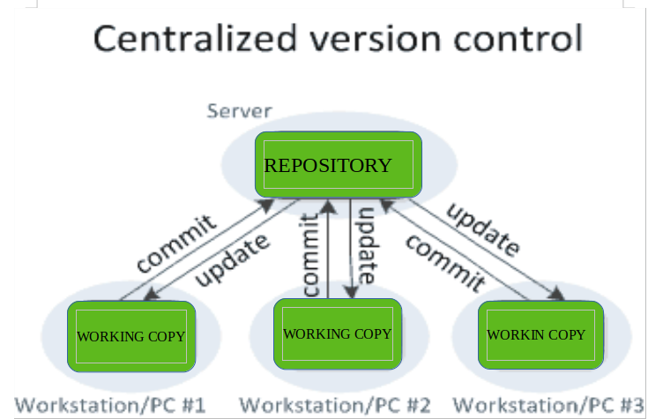
Centralized Version Control Systems: Centralized version control systems contain just one repository and each user gets their own working copy. You need to commit to reflecting your changes in the repository.
It is possible for others to see your changes by updating.
Two things are required to make your changes visible to others which are:
You commit
They update

Slide 16
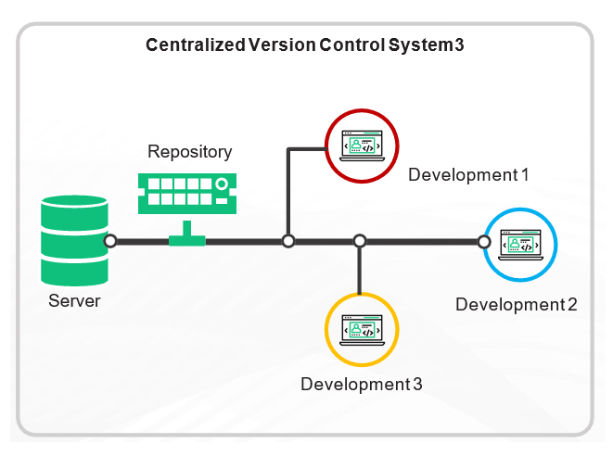

Slide 17
The benefit of CVCS (Centralized Version Control Systems) makes collaboration amongst developers along with providing an insight to a certain extent on what everyone else is doing on the project. It allows administrators to fine-grained control over who can do what.
It has some downsides as well which led to the development of DVS. The most obvious is the single point of failure that the centralized repository represents if it goes down during that period collaboration and saving versioned changes is not possible.
What if the hard disk of the central database becomes corrupted, and proper backups haven’t been kept? You lose absolutely everything.

Slide 18
Problems with Centralized VCSs:
1) Central Repository is the only place where everything is stored, which causes single point of failure. If something goes wrong to the central repository then recovery is very difficult.
2) All commit and checkout operations should be performed by connecting to the central repository via network. If network outage, then no version control to the developer. i.e in this type, developer work space and remote repository server should be connected always.
3) All commit and checkout operations should be performed by connecting to the central repository via network and hence these operations will become slow, which causes performance issues. No local operations and every version control operation should be remote operation.
4) Organization of central repository is very complex if number of developers and files increases.
etc

Slide 19
Distributed Version Control Systems: Distributed version control systems contain multiple repositories. Each user has their own repository and working copy. Just committing your changes will not give others access to your changes.
This is because commit will reflect those changes in your local repository and you need to push them in order to make them visible on the central repository. Similarly, When you update, you do not get other’s changes unless you have first pulled those changes into your repository.
To make your changes visible to others, 4 things are required:
You commit
You push
They pull
They update
The most popular distributed version control systems are Git, Mercurial. They help us overcome the problem of single point of failure.

Slide 20
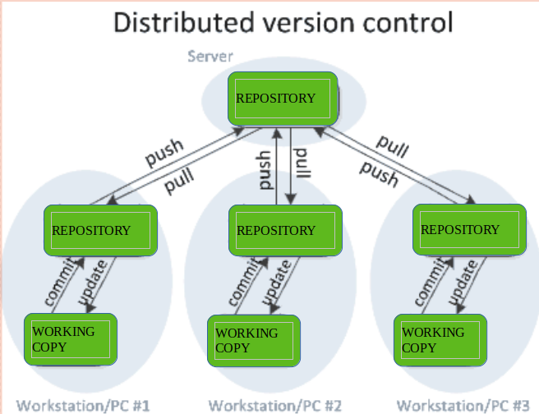

Slide 21
Note:
1) commit and checkout operations will be performed between workspace and repository.
work space – commit - Repository
Repository – checkout - workspace
2) push and pull operations will be performed between repositories.
one repository ---push - other repository
one repository - pull----other repository

Slide 22
Benefits of Version Control System:
We can maintain different versions and we can choose any version based on client requirement.
With every version/commit we can maintain metadata like
commit message
who did changes
when he did the change
what changes he did
3) Developers can share the code to the peer developers in very easy way.
4) Multiple developers can work in collaborative way
5) Parallel development.
6) We can provide access control like
who can read code
who can modify code

